Slide 1
Computer Vision Models / Understanding Deep Learning
Chapters 9 + 19 + UDL’s Chapter 3
Shallow Neural Networks

Slide 2
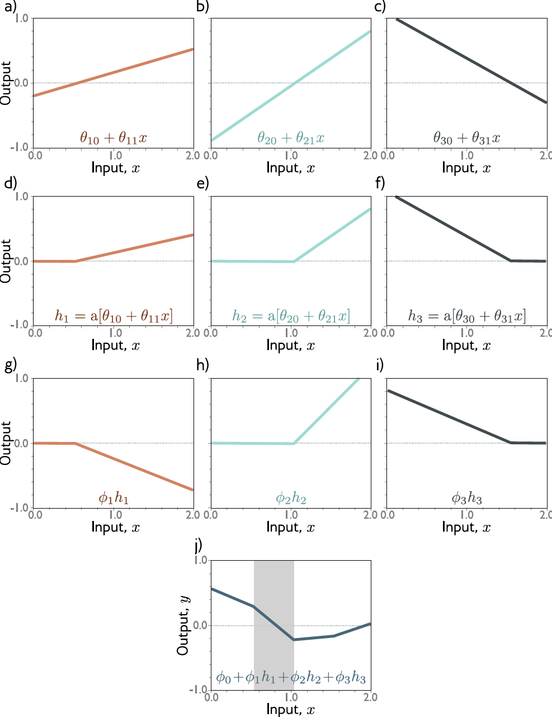
This work is subject to a Creative Commons CC-BY-NC-ND license. (C) MIT Press.

Slide 3
Shallow Network Example

Slide 4


Shallow Network Example

Slide 5
Shallow Network Example

Slide 6
Context Models
Seek Pr(w|x), but where does x come from?
Pre-process?
Raw pixels?
Feature factory?

Slide 7
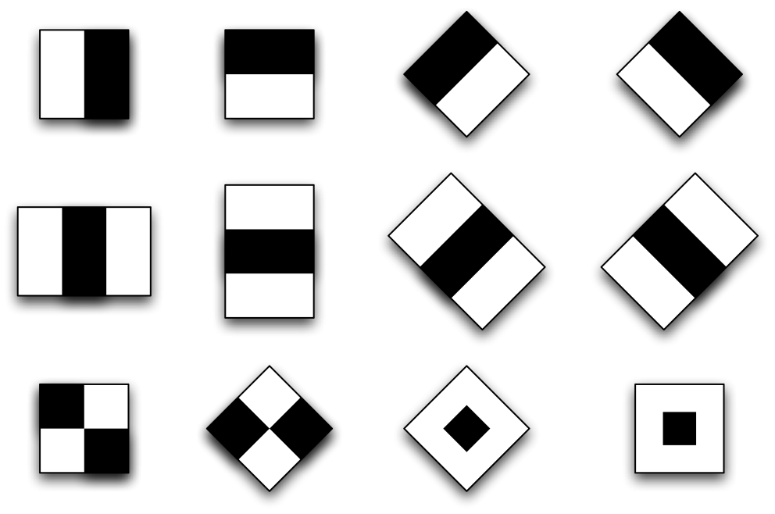
Filter Banks
Transform input data to higher dimension:
z = f[x]
Many standard filters to choose from
Figure by Berggren & Gregersson
Gabor Filters

Slide 8
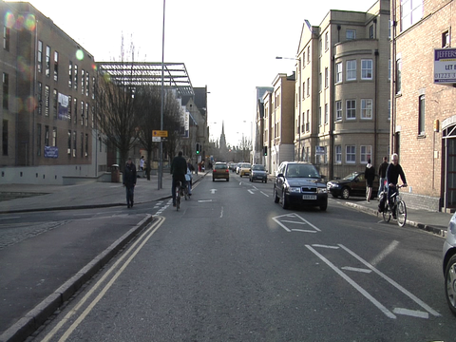
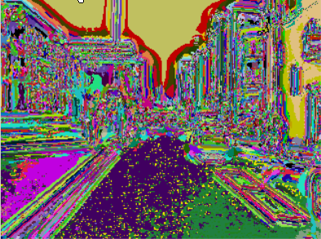
Filter Banks
Textons clustered into Bag-of-Words (video)
Gabor Filter Examples

Slide 9


Slide 10
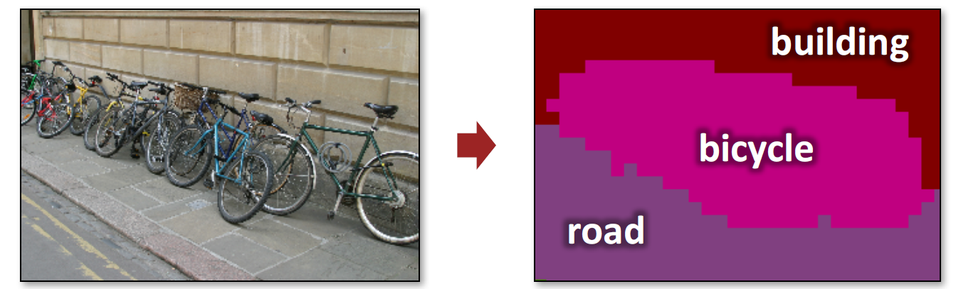
Feature Factory
Instead of hand-made x, choose “family” of x
Ex: Semantic Texton Forests [Shotton’08]

Slide 11
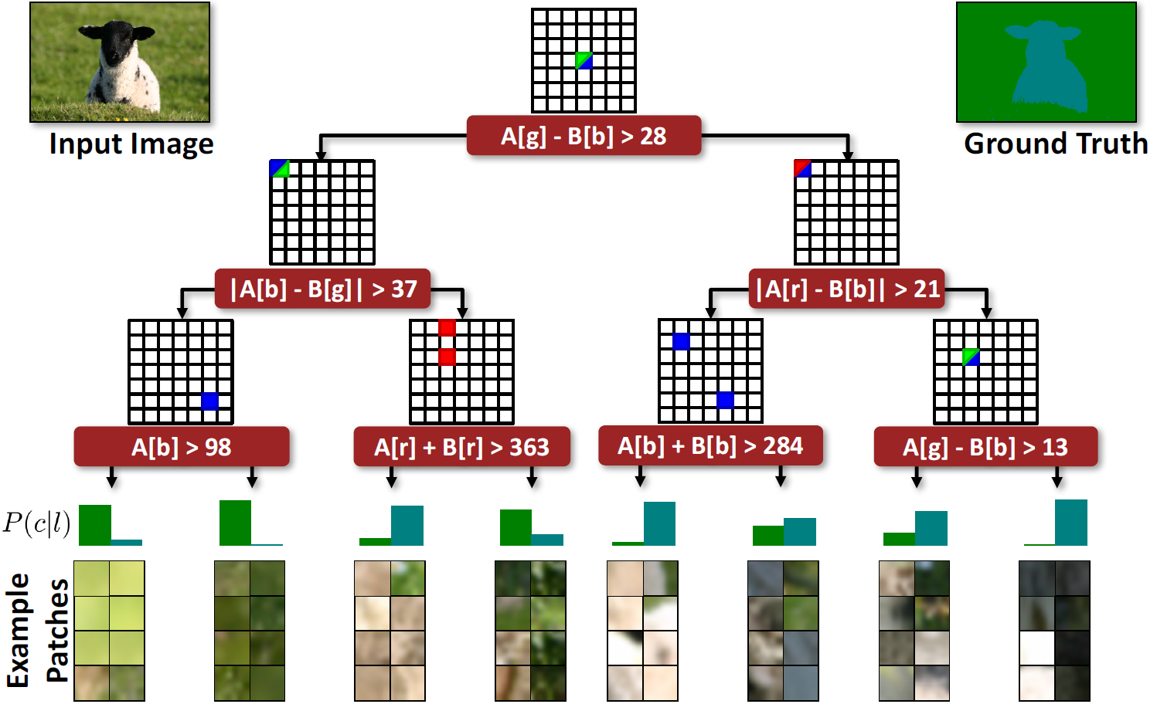
Semantic Texton Forest visualization by Iasonas Kokkinos

Slide 12
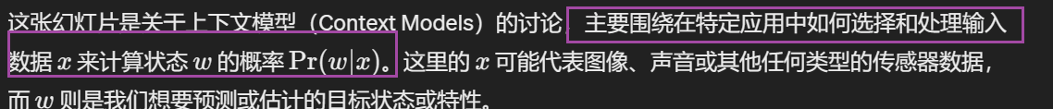
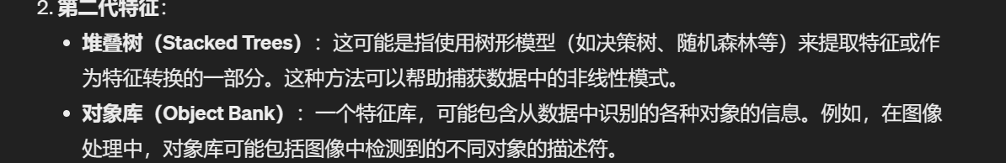
Context Models
Seek Pr(w|x), but where does x come from?
Pre-process?
Raw pixels?
Feature factory?
2nd generation features
Stacked Trees
Object Bank

Slide 13

Stacked Trees

Slide 14
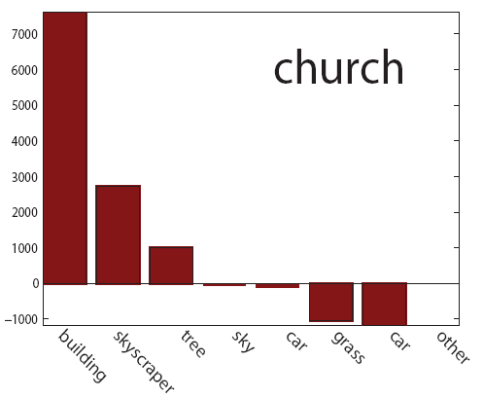
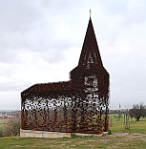


Object Bank
[Li et al. NIPS’2010]
Describe using higher-level representation
Decouple training sets
x is “distributed” representation
Photo: Filip Dujardin

Slide 15
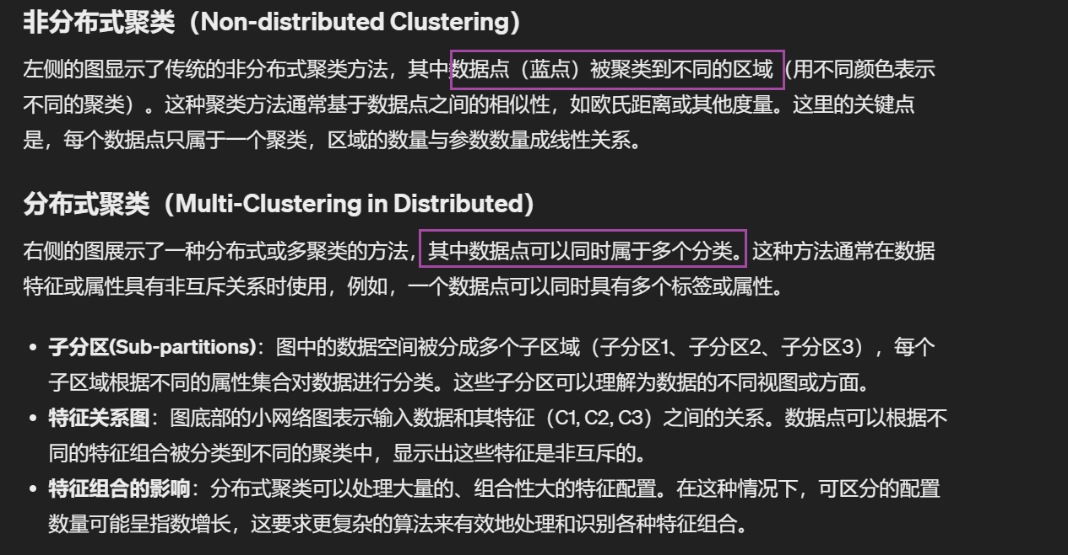
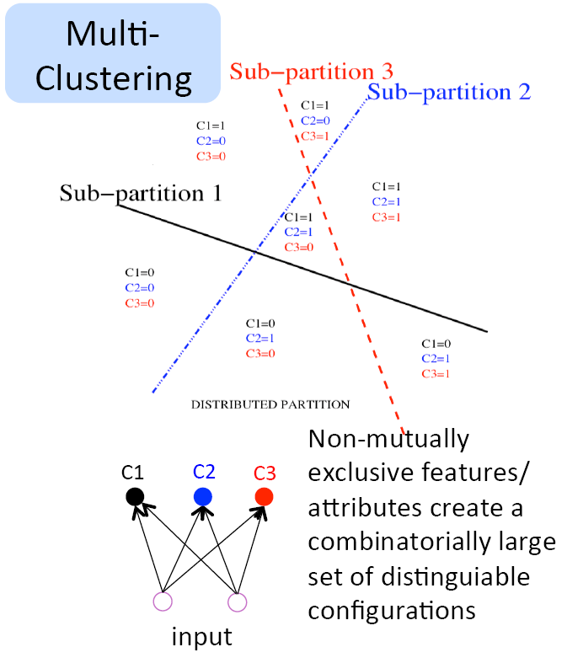
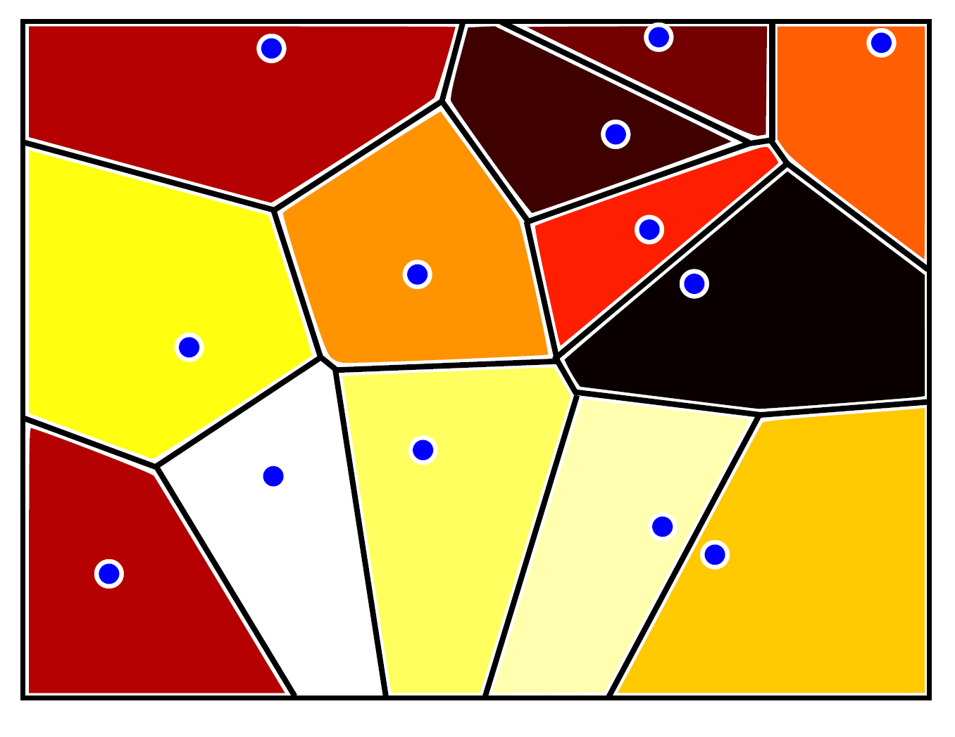



Non-distributed vs Distributed
Clustering
Number of distinct
regions is linear in # params
[Figure from Goodfellow et al. 2016]

Slide 16
Structure
Feed-forward networks
Types of layers
Training using backpropagation
Stochastic gradient descent
Fine-tuning a pre-trained network
Auto-encoders
Practicalities
Computer vision: models, learning and inference. ©2011 Simon J.D. Prince
16

Slide 17
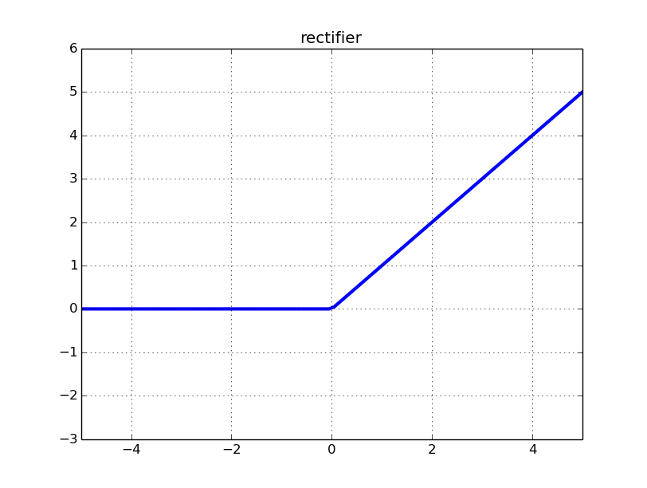

Types of Layers
Rectified Linear Unit (ReLU)
Exponential L.U. (ELU)
Affine
Softmax
Crossentropy Softmax
Cross entropy
more to come…

Slide 18

Types of Layers
Rectified Linear Unit (ReLU)
Exponential L.U. (ELU)
Affine
Softmax
Crossentropy Softmax
Cross entropy
more to come…

Slide 19
Structure
Feed-forward networks
Types of layers
Training using backpropagation
Stochastic gradient descent
Fine-tuning a pre-trained network
Auto-encoders
Practicalities
Computer vision: models, learning and inference. ©2011 Simon J.D. Prince
19

Slide 20
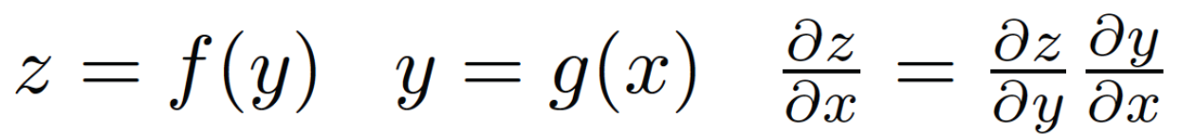
Training Using Backpropagation
See Colah Tutorial
Compute gradient of example-wise loss with respect to parameters
Apply derivative chain rule wisely
If computing the Loss(example, parameters) is O(n) computations, then so is computing the gradient
[From Goodfellow et al. 2016]

Slide 21
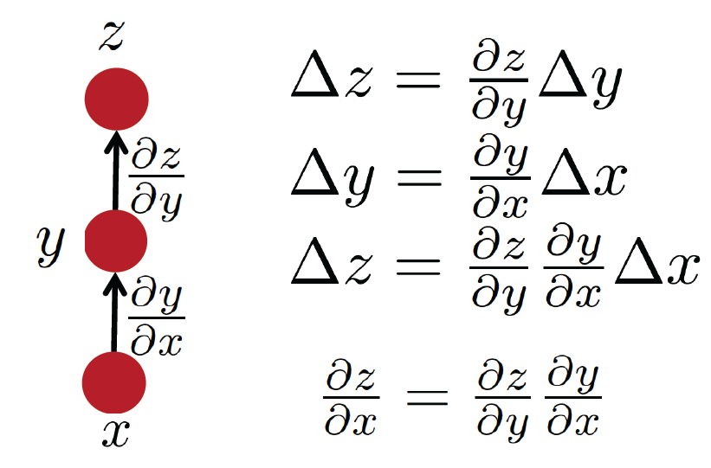
Simple Chain Rule
[From Goodfellow et al. 2016]

Slide 22
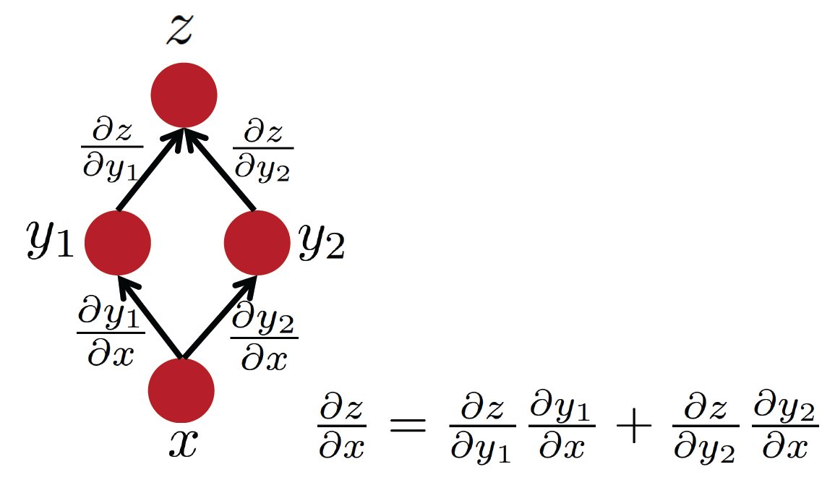
Multiple Paths Chain Rule
Forward-prop: visit nodes in order, compute value given parent
B-prop: Compute gradient wrt each node using gradient wrt offspring
[From Goodfellow et al. 2016]

Slide 23
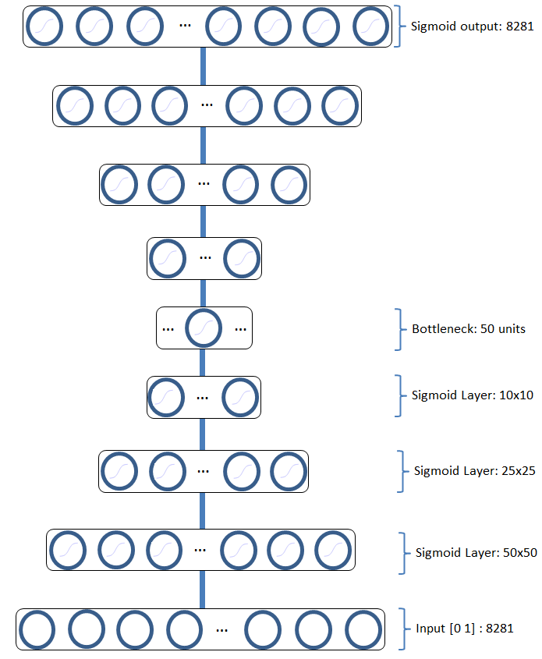
Auto-Encoders
Typical autoencoder architecture
w₁
w₂
w₃
x₁
x₂
x₃

Slide 24
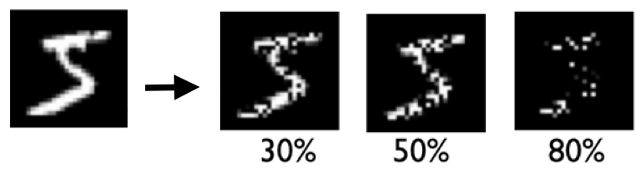
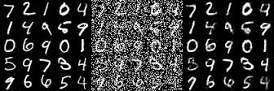
Auto-Encoders
w₁
w₂
w₃
Types of image corruption
x₁
x₂
x₃

